Slide 1
Creation of healthy and caring relationships

Slide 2
Communication is the art of transmitting information, ideas and attitudes from one person to another.
Communication is the process of meaningful interaction among human beings.
Its essences:
• Personal process
• Occurs between people
• Involves change in behavior
• Means to Influence others
• Expression of thoughts and emotions through words and actions.
• Tool for controlling and motivating people.
• It is a social and emotional process.

Slide 3
Communication skiils overview
Effective communication skills are a critical element in your career and personal lives. We all must use a variety of communication techniques to both understand and be understood.
What is communication?
It is a process of sending and receiving information among people.

Slide 4
GOALS OF COMMUNICATION :
To inform – you are providing information for use in decision making.
To persuade – to reinforce or change a belief about a topic.
To build relationships – some messages that you send may have the goal of building good will between you and the other person.
Perfect/Effective - Communication

Slide 5
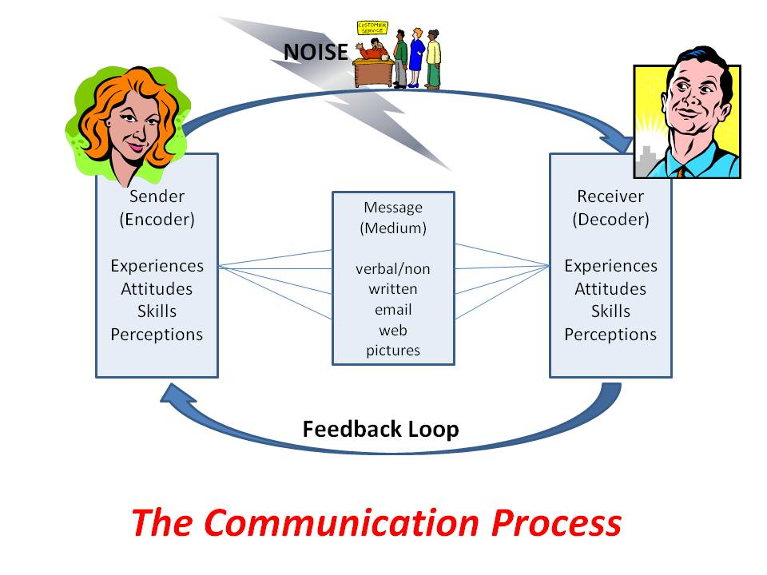

Slide 6
Communication Skills
• Sender: The person who conceptualized the idea and wants it delivered to the recipient.
• Encoding: The way the information is described or translated into a message.
• Message: The idea, fact or opinion that the sender wants to communicate.
• Communication channel: The method of delivering the message.
• Noise or Distraction: Hinders successful communication. Types : Psychological, Physical, Environmental and Semantic.
• Receiver: The target audience of the message.
• Decoding: The interpretation of the message.
• Feedback: The response or action a receiver takes after decoding a message.

Slide 7
BARRIERS TO COMMUNICATION
One person has no interest in the conversation.
You are not able to participate in the discussion due to lack of knowledge on the subject.
Jumping to conclusions without waiting for the whole message.
Fear of offending the other person by expressing your opinions.
You not feel comfortable sharing your feelings with the other person.
Cultural Differences & Language.
One feels not comfortable sharing your feelings with the other person.

Slide 8
Types of Barriers
1. Psychological Barriers
2. Physical Barriers
3. Emotional Barriers
4. Attitudinal Barriers
5. Cultural Barriers
6. Language Barriers
7. Gender Barriers
8. Interpersonal Barriers

Slide 9
WAYS TO IMPROVE COMMUNICATION :
Understanding is the KEY to communication.
Understanding requires ACTIVE LISTENING.
Speak up about your thoughts and ideas
Try not to make assumptions
Practice self-awareness, especially during tough conversations
Don’t be accusatory when raising an issue
Be brief and clear
Eye Contact

Slide 10
Friends and friendship - education
Friend
a person with whom one has a bond of mutual affection
a person who has a strong liking for and trust in another person.
a person who is not an enemy friend or foe.
a person who helps or supports something.
Unconditional Relationship.

Slide 11
Friendship:
"Friendship is a relationship of mutual affection between people. It is a stronger form of interpersonal bond than an acquaintance or an association, such as a classmate, neighbour, or colleague. “
It is a dyadic relationship, meaning that it involves a series of interactions between two individuals known to each other.
• It is recognized by both members of the relationship and is characterized by a bond or tie of reciprocated affection.
• It is not obligatory; two individuals choose to form a friendship with each other.

Slide 12
Characteristics of Friendship
• It is typically egalitarian (all are equal) in nature. Each individual in a friendship has about the same amount of power or authority in the relationship.
It is almost always characterized by companionship and shared activities.
One of the primary goals and motivations of friendship is companionship.
In addition, adolescent and adult friendships often perform other functions, such as serving as sources of emotional support and providing opportunities for self-disclosure and intimacy.

Slide 13
Qualities Of A True Friend
• A faithful friend is a sure anchor
• Will always be honest with you.
• Loves you for yourself and unconditional
• Gives more than they take Compromises
• forgives you even without an apology.
• believe in you.
• Make time for you.
• Respectful to you.
• Thoughtful.
• Stick around you.

Slide 14
Friendship in Education
They provide support and resources and can both encourage and discourage academic achievement.
Contribute to a positive sense of mental well-being,
Encourage learning and develop interpersonal skills
play a significant role in promoting overall health.
Development of Social Skills
Better Cooperation
Better Problem solving abilities
Better Communication
Better Academic outcomes

Slide 15
Why communication is key to healthy relationships
Communication is important in any relationship, as it allows you to effectively share feel-ings, opinions and expectations.
GET TO KNOW EACH OTHER : The key to determining whether you’re compatible with another person is to communicate with them from the offset.
AVOID MISUNDERSTANDING : Another reason to communicate effectively is to avoid any misunderstandings, which can lead to a breakdown of communication or the relation- ship as a whole.

Slide 16
SET CLEAR EXPECTATIONS : In any relationship, it’s important that these expectations are made clear from the offset, to avoid one party upsetting the other without realizing.
Always be open and honest and never be afraid to stand by what you believe in.Thus healthy, positive and satisfying relationship.

Slide 17
How to improve communication in a relationship?
• Always talk about important or sensitive issues face-to-face.
• Be open and honest.
• Find the right time for important conversations Don’t be abusive or verbally aggressive, even if it’s an emotive issue.
• Approach conversations in a calm and relaxed way, in a quiet environment where both parties are comfort-able.
• Use positive body language.
• Do not communicate via text.
• Choose your language carefully.

Slide 18
The value of relationships and communication
Examples of Bad communication in relationships
• Belittling each other
• Openly giving the cold shoulder
• Becoming defensive in heated discussions
• Assuming you know what the other person is thinking
• Arguments that are never resolved and brushed under the carpet
• Inability to compromise
• Few attempts to connect

Slide 19
Examples of good communication in relationships
• Giving your partner, friend or family member your full attention.
• Giving each other space when needed.
• Face-to-face communication.
• Honesty and openness.
• 24- hour rule – never sleep on an argument.
• Talk about the little things in life

Slide 20
Relationships for Better or worsening of life
Satisfying relationships not only make us happy, they also influence our long-term health as much as getting enough sleep, eating healthy, and not smoking.
Many research studies have shown that satisfying relationships are associated with better health, greater happiness, and even longer life.
Stronger Heart and Healthier Brain
An unhealthy relationship will cause lot of stress, loneliness and will make us an irritable person which will work as a retarding force in our way of achieving success.
While in an unhealthy relationship we lose trust on each other and respect for each other decreases.

Slide 21
Understanding of basic instincts of life (more than a biology)
Two Basis instincts of Human Life
Self-Preservance.
Social Instinct.
Self-Preservance:
Focused on enhancing and protecting personal safety, security, and comfort.
Priorities: Physical well-being, financial security, mental health.
Characteristics: This type tends to be self-sufficient, disciplined, and devoted to self-improvement. Exam-ple:Investing in the future.

Slide 22
Social Instinct
• Focused on creating and maintaining relationships to build a sense of personal value, ac-complishment, and community.
• Priorities: Interpersonal relationships, group participation.
• Characteristics: Healthy social types typically maintain many friendships, feel a strong sense of social re-sponsibility, and work to protect the group.
• Weaknesses: Social types may develop an antisocial “us against them” attitude in an effort to determine who’s on their side.

Slide 23
Change health behaviours through social engineering
Social engineering involves modifying the environment in ways that effects people ability to practice a particular health behaviour.
Examples of social engineering:
Wearing seat belt is an active measure of to control the possible injury from an automobile accident, where as airbags which inflate automatically on impact.
Both smoking and alcohol consumption are legally restricted.
Social engineering solutions include providing purified water to people.

Slide 24
Both smoking and alcohol consumption are legally restricted to particular circumtances and age groups.
The media can be used to influence people towards making healthier choices especially children who are suggestible and vulnerable to advertising.
Facilitating development of health habits such as open spaces and parks that encourage people to exercise, relatively cheap organic fruits and vegitables, minimal marketing of tobacco and alcohol.
Banning the usage of certain drugs, such as heroin and cocaine and regulating the disposal of toxic wastes are example of health measures that have been mandated by legislation.

